Slide 1
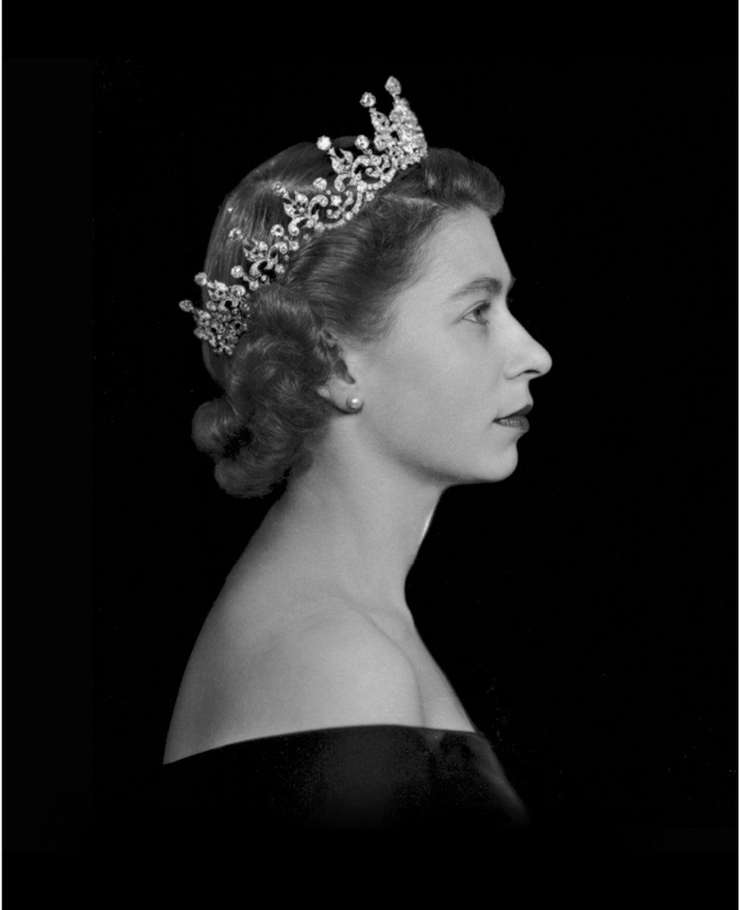
Queen Elizabeth II
21st April 1926 –
8th September 2022

Slide 2
This is the moment history stops; for a minute, an hour, for a day or a week; this is the moment history stops

Slide 3
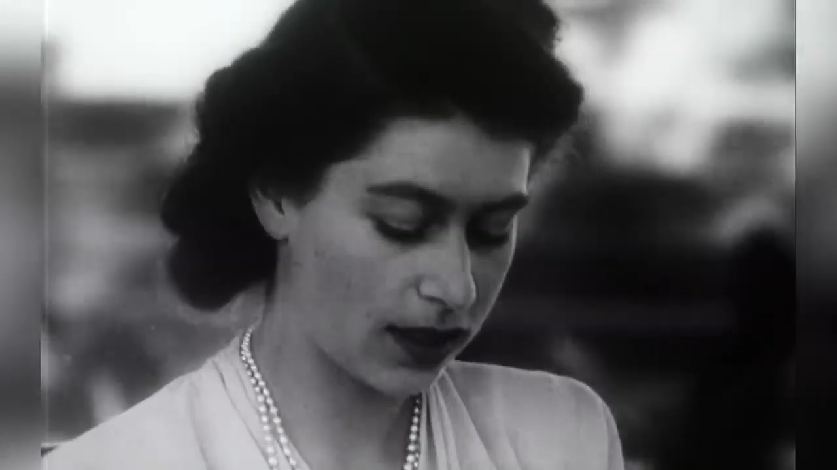
1947 – Princess Elizabeth dedicates herself to the nation

Slide 4
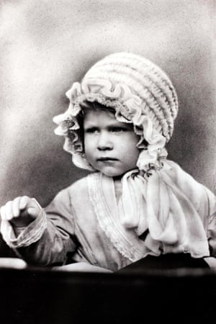
1927: Princess Elizabeth, one. She was third in line to the throne behind her father, the Duke of York, and Edward, Prince of Wales.

Slide 5
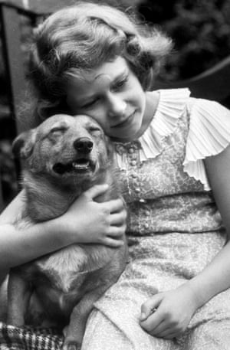
1936: Elizabeth was fond of her parents’ corgis from a young age. She received her first corgi, Susan, as an 18th birthday present and has owned more than 30 since she became Queen.

Slide 6
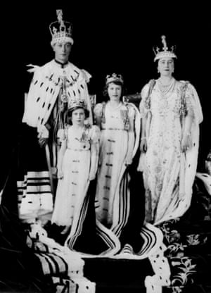
1937: King George VI ascended the throne after his brother, Edward VIII, abdicated. This made Princess Elizabeth the heir to the throne – something she had never expected as a child.

Slide 7
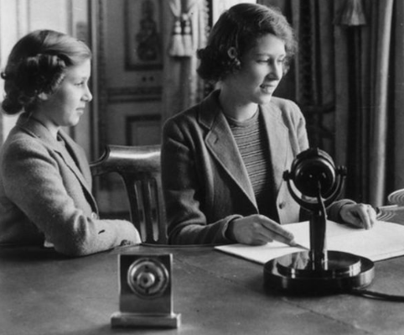
She lived through the Second World War and remained at Windsor Castle instead of moving abroad.
She kept the country positive with radio messages she broadcast with her sister - Margaret.
She was only 14 when she first gave a radio message.

Slide 8
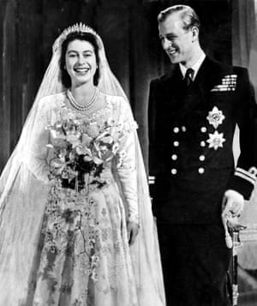
1947: Princess Elizabeth marries Philip Mountbatten at Westminster Abbey. He becomes the Duke of Edinburgh.

Slide 9
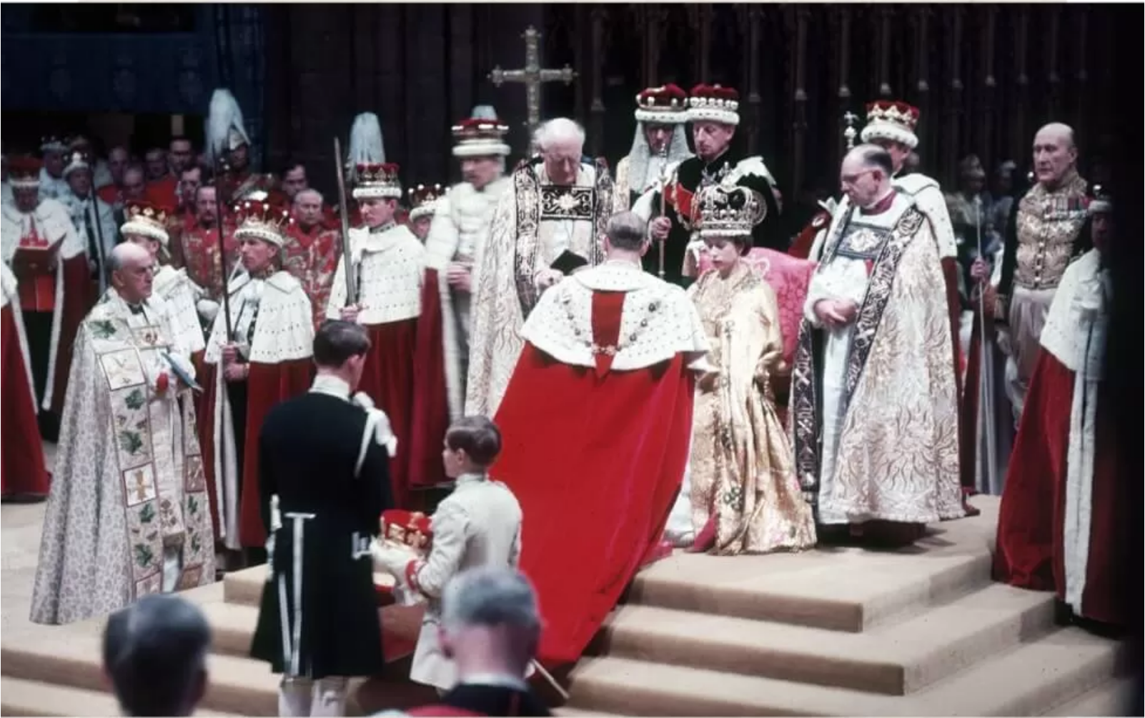
1953 - Service to the nation begins as Elizabeth is crowned Queen in Westminster Abbey.

Slide 10
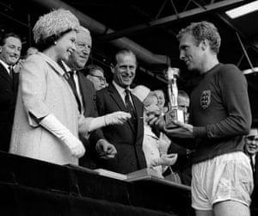
1966: the England captain Bobby Moore holds the World Cup, collected from the Queen, after leading his team to a 4-2 victory over West Germany at Wembley stadium in London.

