Slide 1
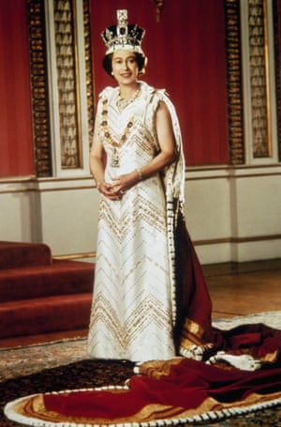
1977: Queen Elizabeth II poses for a silver jubilee portrait in the throne room of Buckingham Palace. More than a million people line the streets of London in celebration, and a chain of beacons is lit across the country.

Slide 2
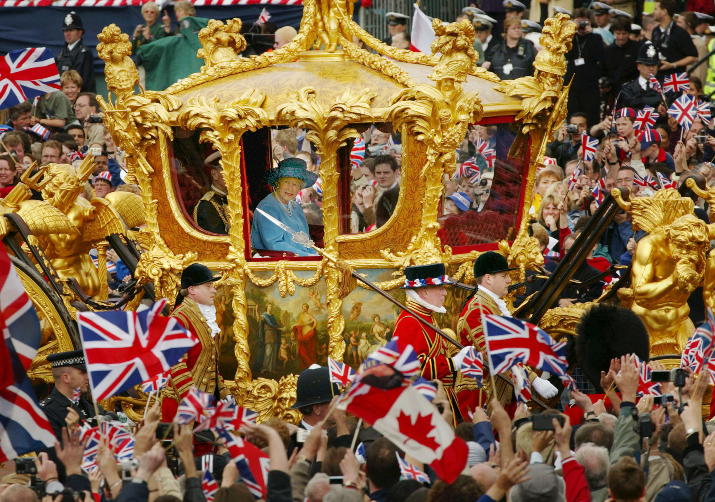
2022: The Queen celebrated her Platinum Jubilee – 70 years on the throne!

Slide 3
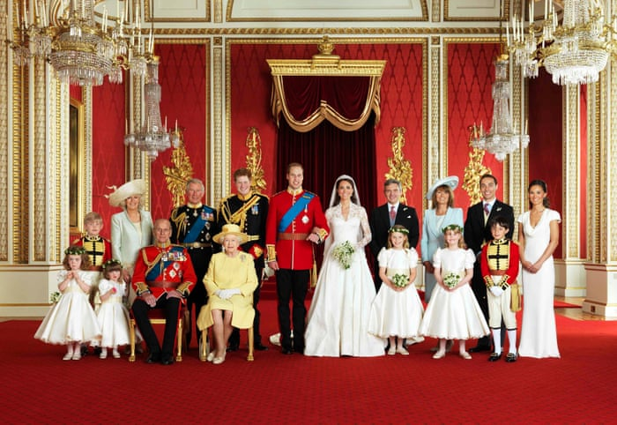
The Queen had 4 children, 8 grandchildren and 12 great-grandchildren.

Slide 4
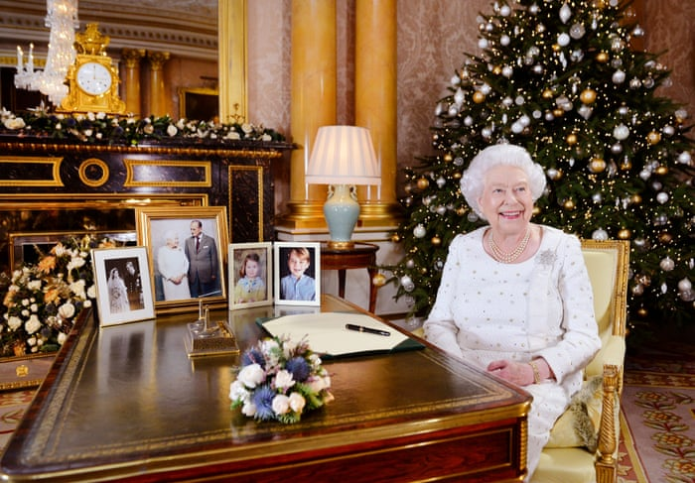
The Queen made her first Christmas Day speech in 1952. She made 69 Christmas Day messages in her lifetimes and has sent over 50,000 Christmas cards to family, friends and politicians across the world.

Slide 5
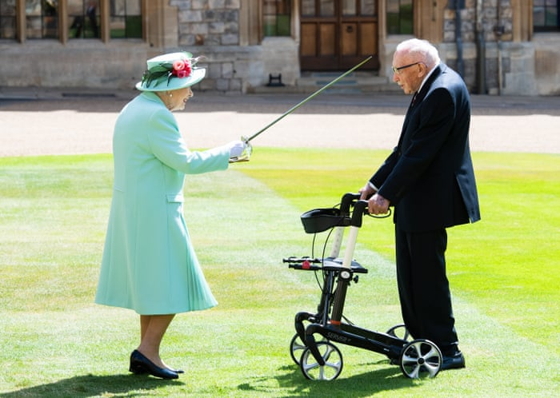
The Queen knighted hundreds of people and gave thousands of medals to ordinary members of the public. Here she is knighting Sir Captain Tom Moore in 2020.

Slide 6
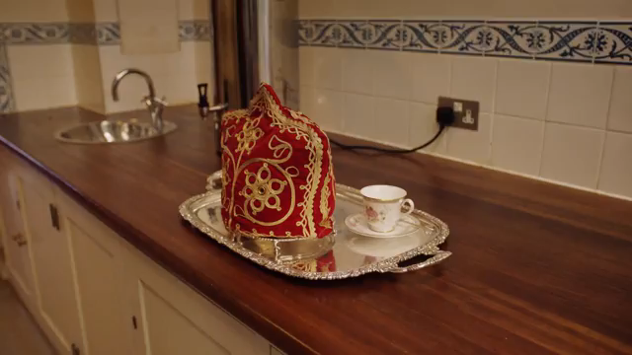
The Queen never stopped working for the country, but did find time to have a little bit of fun too…

Slide 7
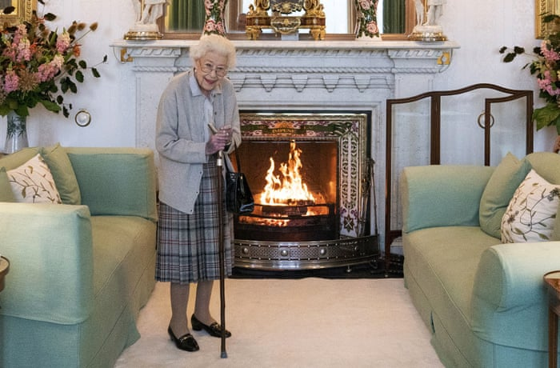
Queen Elizabeth worked until the very end… always serving her country.
"I declare before you that my whole life - whether it be long or short - shall be devoted to your service."

Slide 8
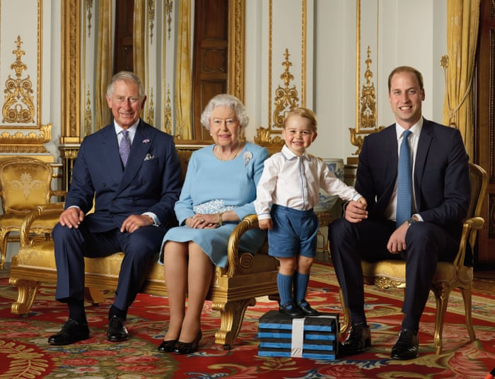
The Queen with Prince Charles, Prince William and Prince George – the four generations in line to be monarch.

Slide 9
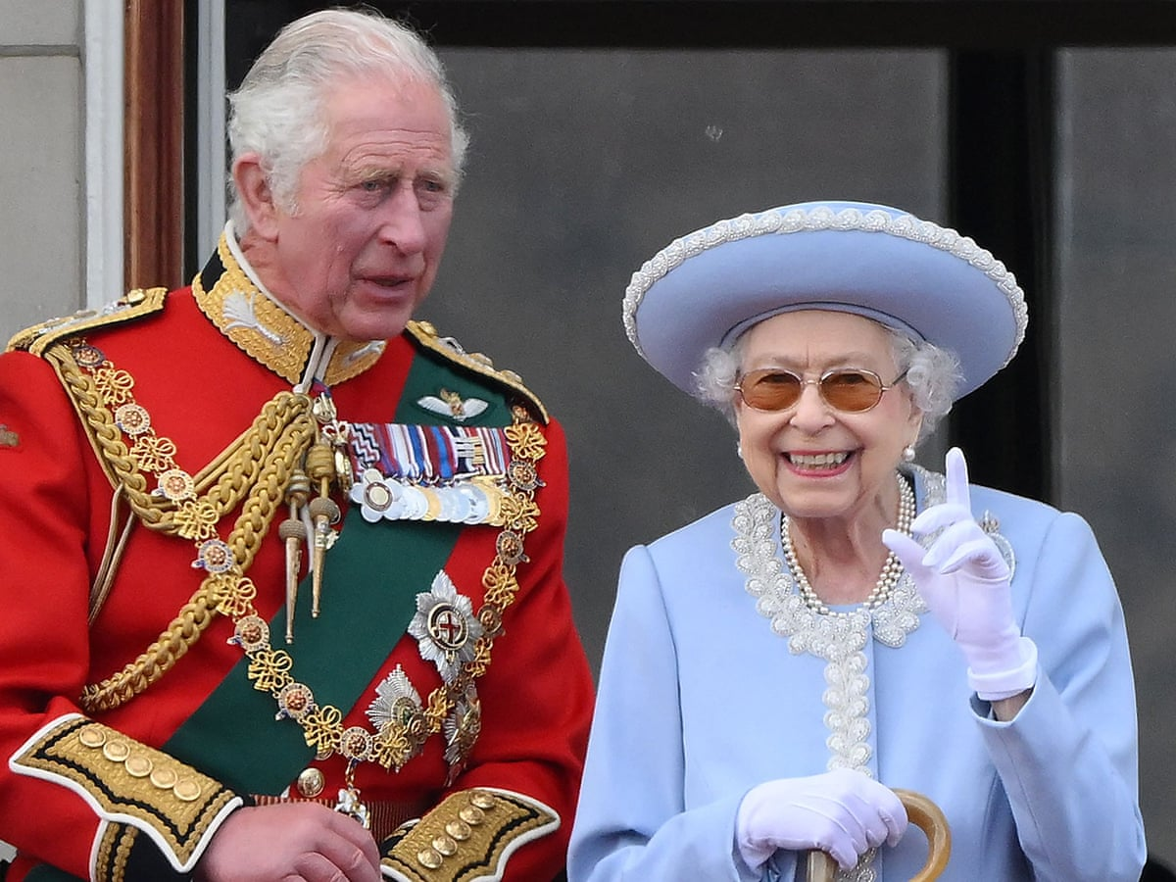
On the death of his mother, Queen Elizabeth, Prince Charles became King Charles III, the new monarch of the United Kingdom.

Slide 10
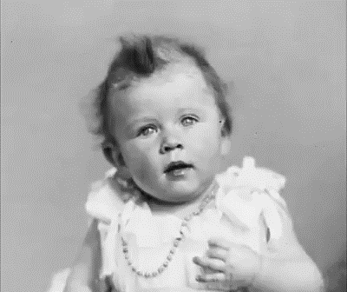
But for now we remember and celebrate the life of Queen Elizabeth II, the longest reigning British Monarch.

Slide 11
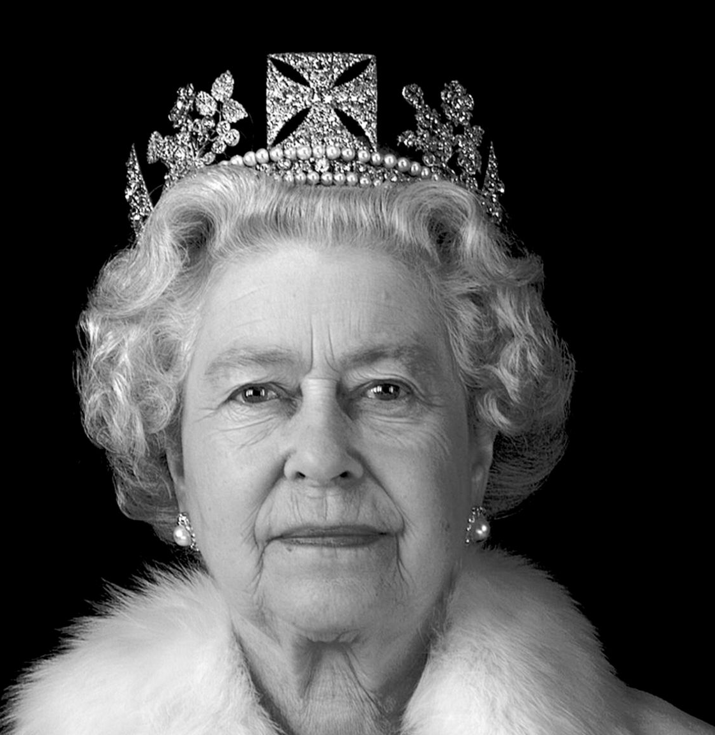
Queen Elizabeth II
21st April 1926 –
8th September 2022

